Slide 1
NBA Draft Measurement
Data Analysis

Slide 2
Objective
PowerBi dashboard for monitoring NBA Draft combine measurement claim for Private
motor products . The dashboard will analysis all the details related to the analysis of the player by year
Benefits:
Show all the player details.
Height and weight by year.
Body fat by year.
Count of weight by year.

Slide 3
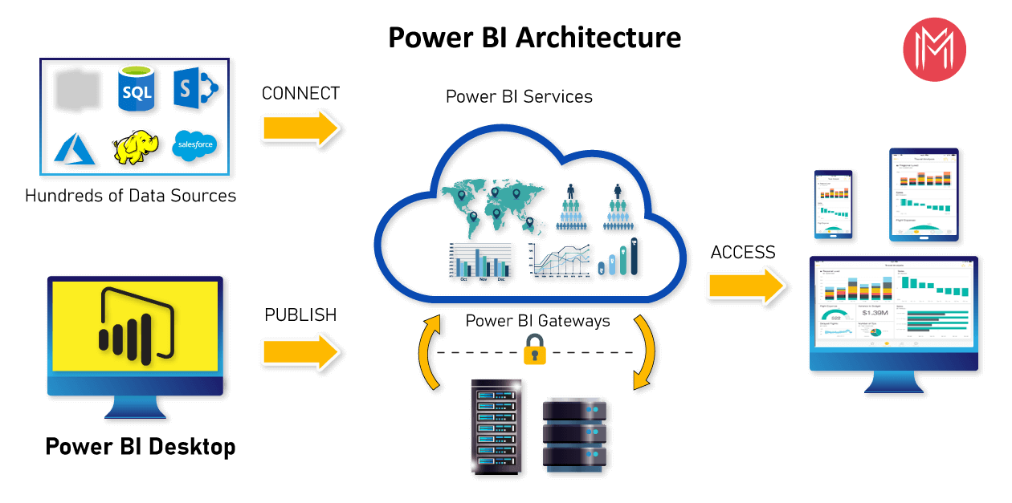
Architecture

Slide 4
Data Validation and Transformation
Power BI Desktop is an excellent tool for ETL (extract, transform and load) operations and can perform almost any transformation that its big brother, SSIS (SQL Server Integration Services) can.
Most ETL operations can be performed with no code – this is a big plus for those new to Power BI or for rapid report development. Advanced ETL operations are available using DAX and R languages.
Load:
Rename the Query
Rename Columns
Rename Rows and Column
Rename rows with filter
Remove Duplicates
Merge columns
Replace Values
Format text
Change Data types
Add a custom column.

Slide 5
Data Insertion in Database:
Table creation :- Table name “NBA Draft per year(2012-2016)" is created in the database for
inserting the files. If the table is already present then new files are inserted in the
same table.
Insertion of files in the table - All the files are inserted in the above-created table. If any file has invalid data type in any of the columns,
the file is not loaded in the table

Slide 6
Model Training:
Data Export from Db.
The accumulated data from db. is exported in csv format for model training
Data Preprocessing
Performing EDA to get insight of data like identifying distribution , outliers ,trend
among data etc.
Check for null values in the columns. If present impute the null values.
Encode the categorical values with numeric values.
Perform Standard Scalar to scale down the values.

Slide 7
Dashboard:
The visualizations you see on the dashboard are called tiles. You pin tiles to a dashboard from reports. If you're new to Power BI, you can get a good foundation by reading Basic concepts for designers in the Power BI.
The visualizations on a dashboard originate from reports and each report is based on a dataset. One way to think of a dashboard is as an entryway to the underlying reports and datasets. Selecting a visualization takes you to the report (and dataset) that it's based on.

Slide 8
Q & A
Q1) What’s the source of data?
The data for training is provided by the client in multiple batches and each batch contain multiple files
Q 2) What was the type of data?
The data was the combination of numerical and Categorical values.
Q 3) What’s the complete flow you followed in this Project?
Refer slide 5th for better Understanding
Q 4) After the File validation what you do with incompatible file or files which didn’t pass the validation?
Files like these are moved to the Achieve Folder and a list of these files has been
shared with the client and we removed the bad data folder.

Slide 9
Q 5) How logs are managed?
We are using different logs as per the steps that we follow in validation and
modeling like File validation log , Data Insertion ,Model Training log , prediction log
etc.
Q 6) What techniques were you using for data pre-processing?
1.Removing unwanted attributes
2.Visualizing relation of independent variables with each other and output variables
3.Checking and changing Distribution of continuous values
4.Removing outliers
5.Cleaning data and imputing if null values are present.
6.Converting categorical data into numeric values. Scaling the data

